Slide 1

LUNARX
a game inspired by Moonlander
created by Tejasvi Kothapalli and Andrew Kou

Slide 2

TODAY’S JOURNEY
TURUBLENCES
GAME OVERVIEW
CLASS DETAILS
TEST FLIGHT!
MEET THE PILOTS
CLASS OVERVIEW
PROJECT REVIEW

Slide 3


MEET THE PILOTS
TEJASVI KOTHAPALLI
ANDREW KOU
IN CHARGE OF:
ROCKET MECHANICS
PHYSICS (GRAVITY, VELOCITY, ETC. )
ZOOMED FRAME
LANDING
IN CHARGE OF:
LANDSCAPE GENERATION
EXPLOSION
PLAYER DISPLAY
STAR GENERATION

Slide 4




GAME OVERVIEW
Objective: To gain the most amount of points by landing safely on the platforms before you run out of fuel
Key Features
Landscape Zooming
Landing/Explosion Functionality
Rocket Physics
Random Landscape Generation

Slide 5
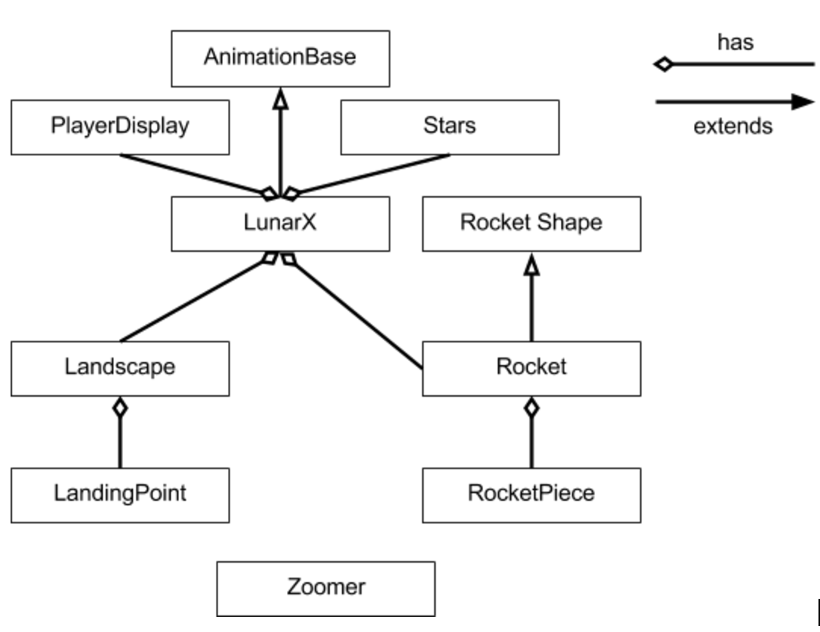
CLASS HEIRARCHY

Slide 6
ANIMATION BASE CLASS
provides a generic framework for applets that do simple animations
Methods
void drawFrame(…) void setFrameCount(…)
int getFrameNumber() void setMillisecondsPerFrame(…)
int getWidth() int getTimePerFrame()
int getHeight() void start()
long getElapsedTime() void stop()
void actionPerformed() int getFrameCount()

Slide 7
LUNARX CLASS
the main of the program
Fields
Rocket rocket
Random rand
Landscape land
Stars stars
boolean upArrow
boolean rightArrow
boolean leftArrow
boolean spacebar
PlayerDisplay playerInfo
boolean exploded
boolean started
boolean gameOver
boolean first
Methods
void init()
void keyReleased()
void keyPressed()
void drawFrame()
+getters

Slide 8
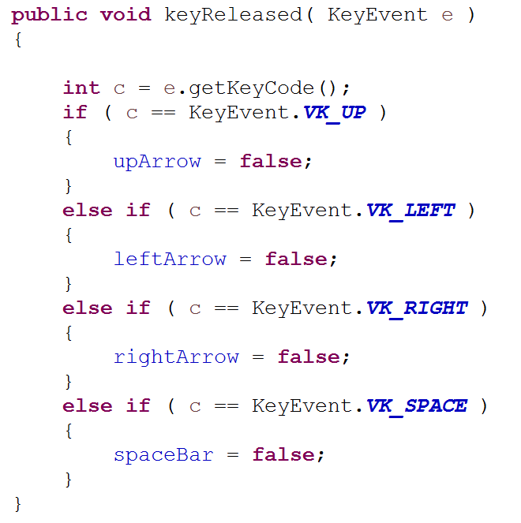
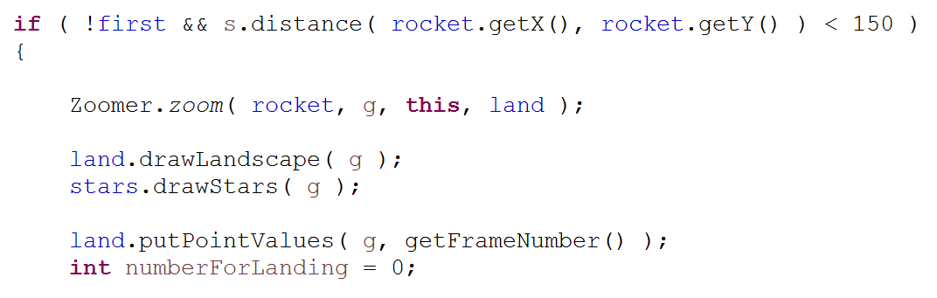
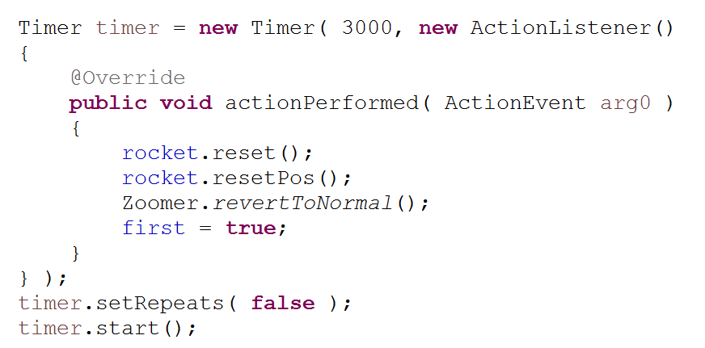
LUNARX CLASS
init()
doFrame()

Slide 9
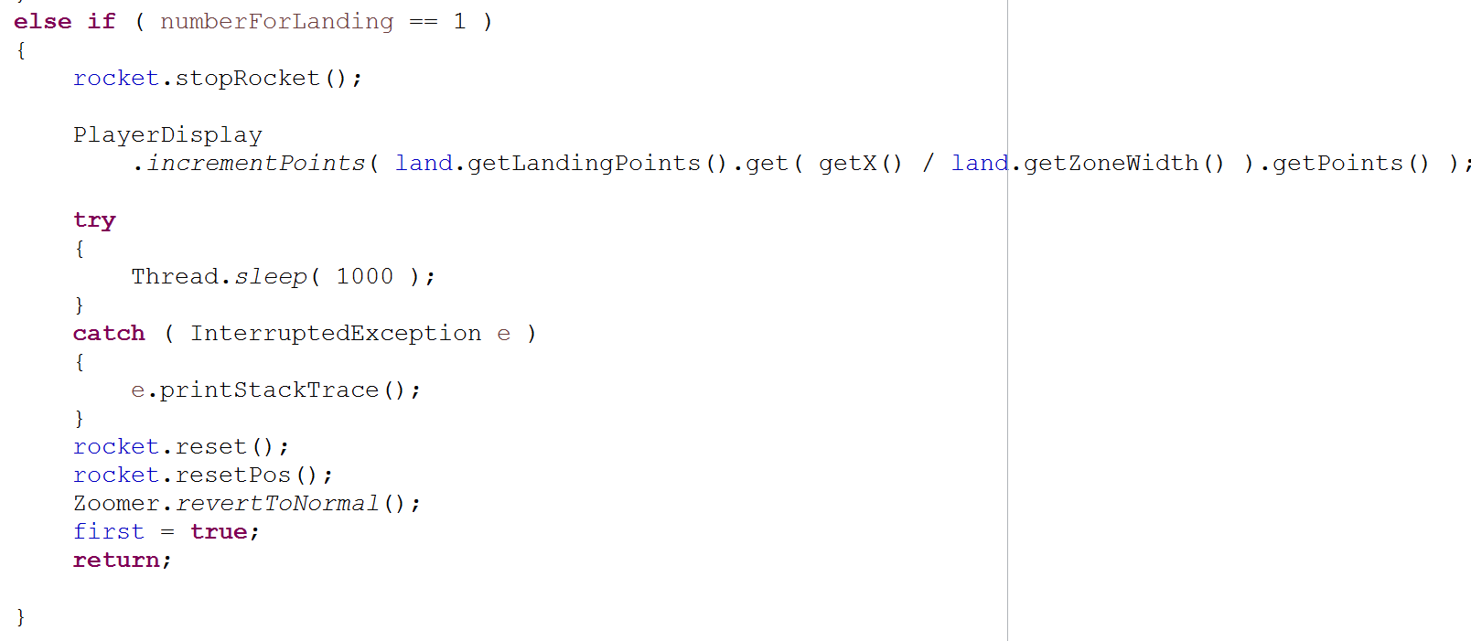
LUNARX CLASS
doFrame()

Slide 10
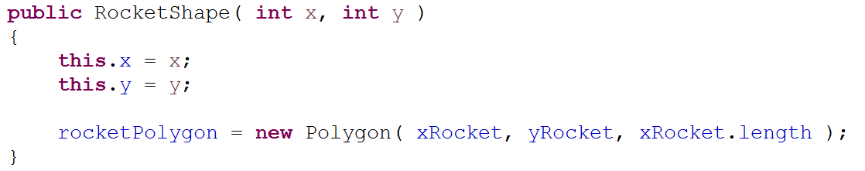
ROCKETSHAPE CLASS
the shape of the rocket
Fields
int x, y
int angleOfRocket
double rocketScaleFactor
Polygon rocketPolygon
int[] xRocket
int[] yRocket
int[] xFlame
int[] xFlameOrig
int[] yFlame
ct
Constructor

Slide 11
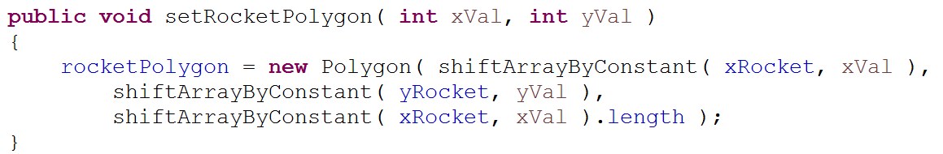
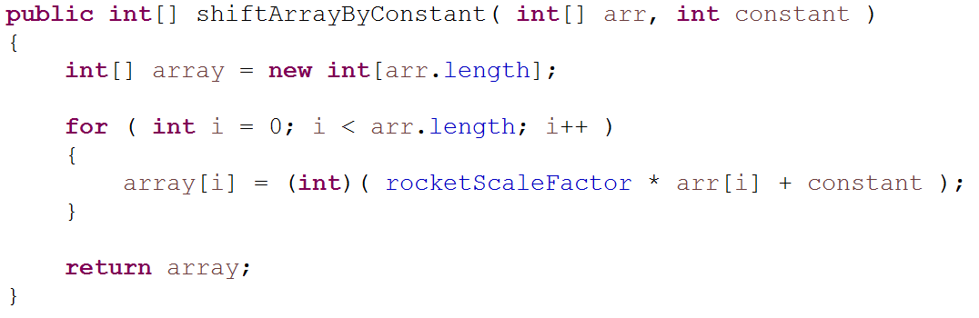
ROCKETSHAPE CLASS
Methods
int drawFilled(…)
void setRocketPolygon(…)int[] shiftArrayByConstant(…)
void setPosition(…)
void resetPos()
int getXToRotateAbout()
int getYToRotateAbout()
+getters
setRocketPolygon(…)
shiftArrayByConstant(…)

Slide 12
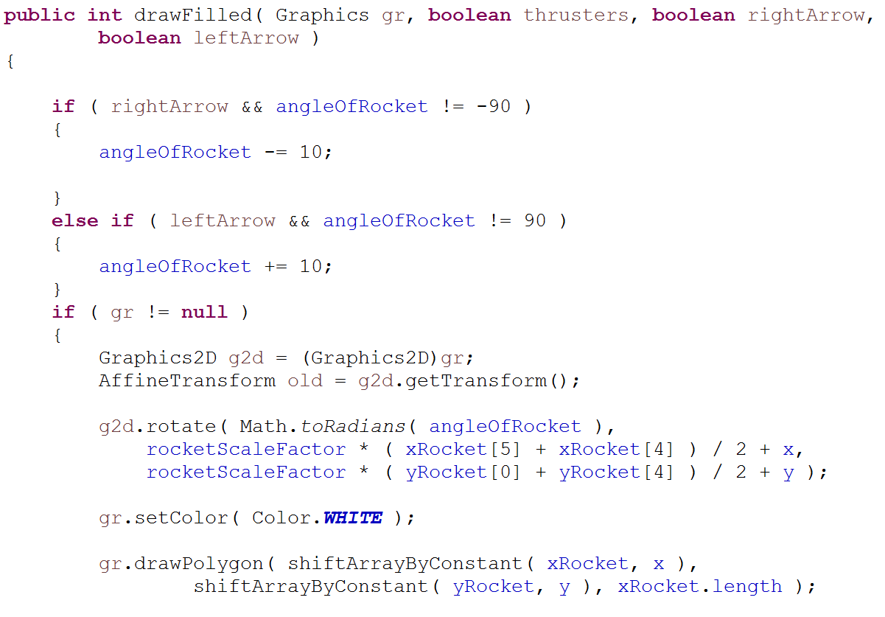
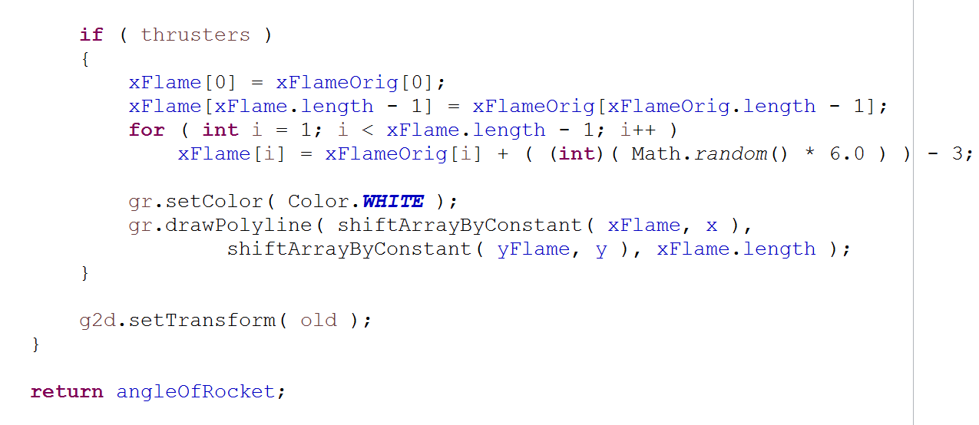
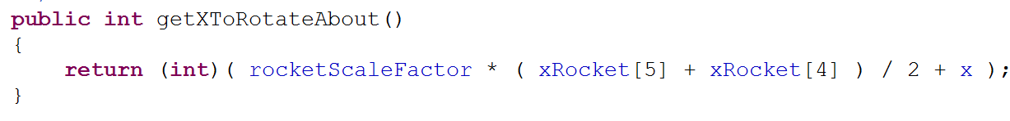
ROCKETSHAPE CLASS
drawFilled(…)
getXToRotateAbout(…)

Slide 13
ROCKET CLASS
Methods
void doFrame(…)
int findPositionX(…)
int findPositionY(…)
double findVelocityX(…)
double findVelocityY(…)
double findAccelerationX(…)
double findAccelerationY(…)
int getPoints()
void explode()
int getCrashNum()
int checkForLanding()
void decrementFuel()
void stopRocket()
void reset()
+ getters
Non-visual components of the rocket
Fields
double velocityX
double velocityY
double airResistance
double gravity
double upArrow
int angleOfRocket
int points
LinkedList rocketPieces
int crashX
int crashY
int crashNum
int fuel

Slide 14
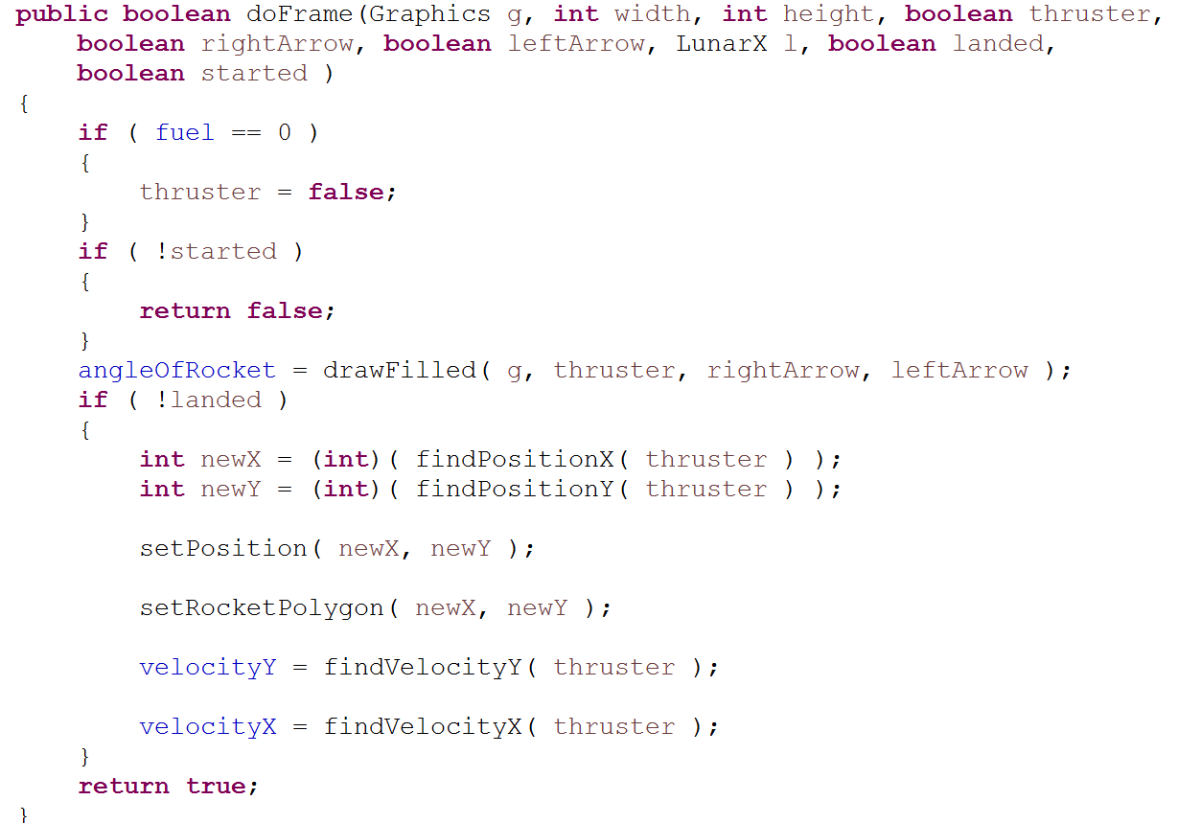
ROCKET CLASS
doFrame(…)

Slide 15
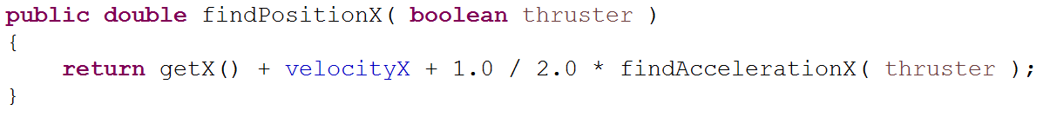
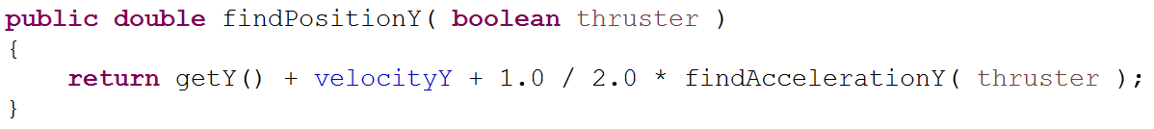
ROCKET CLASS (cont.)
Methods
findPositionX(…)
findPositionY(…)

Slide 16
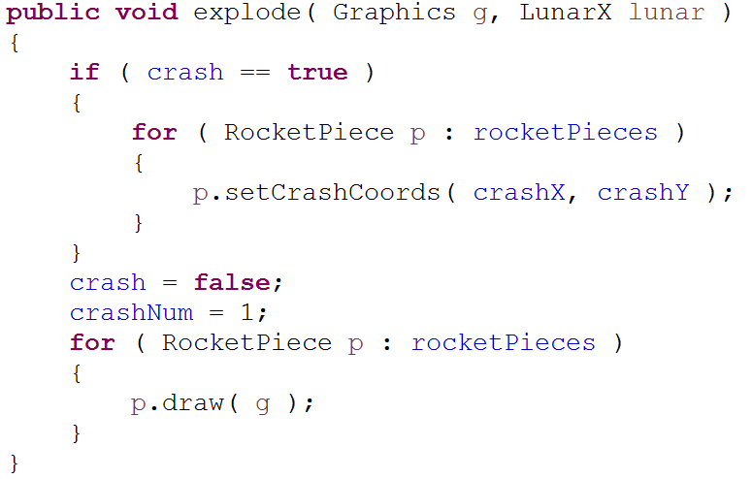
ROCKET CLASS (cont.)
Methods
explode(…)

Slide 17
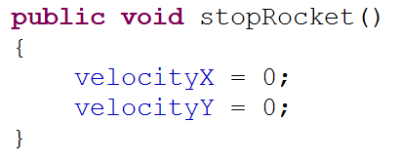
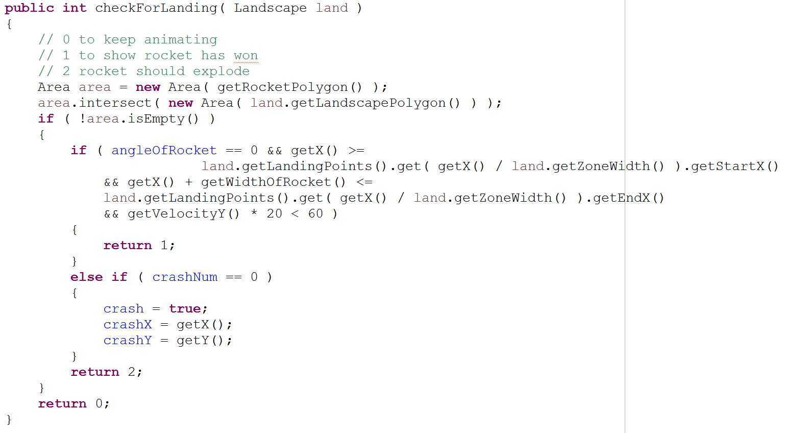
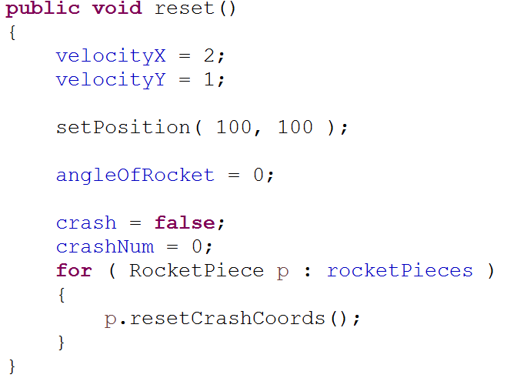
ROCKET CLASS (cont.)
stopRocket()
Methods
checkForLanding(…)
reset()

Slide 18
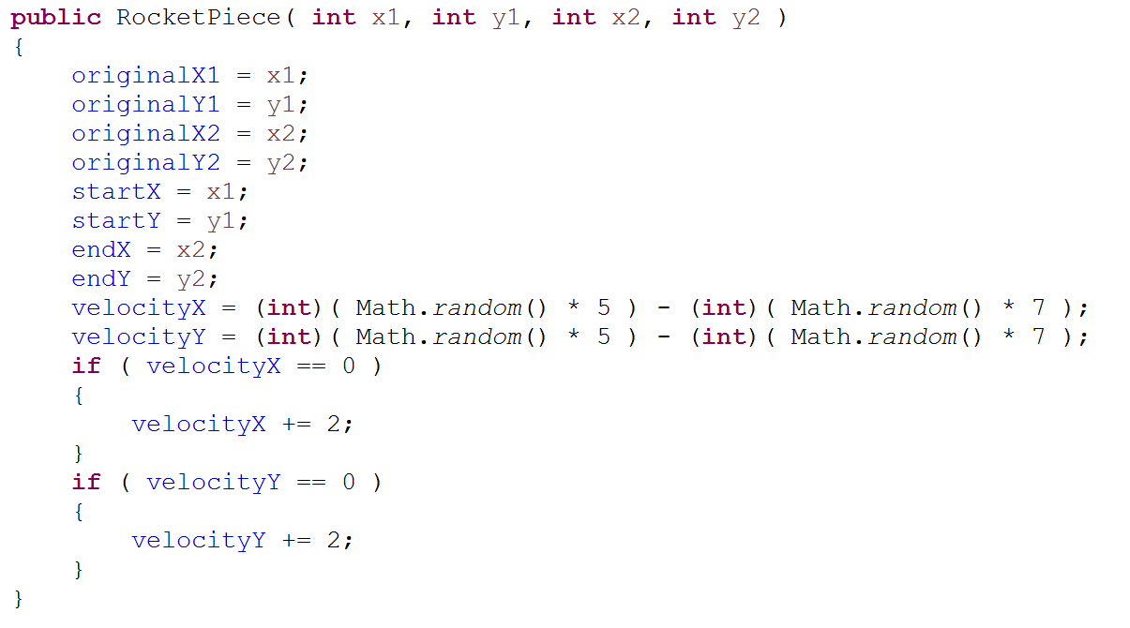
ROCKETPIECE CLASS
individual piece of the rocket
Constructor
Fields
int originalX1
int originalX2
int originalY1
int originalY2
int startX
int startX
int endX
int endY
int velocityX
int velocityY

Slide 19
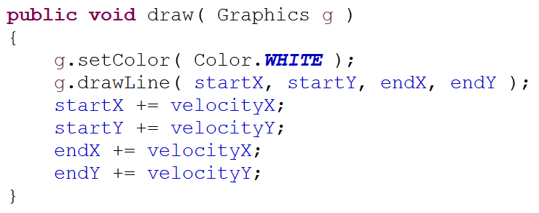
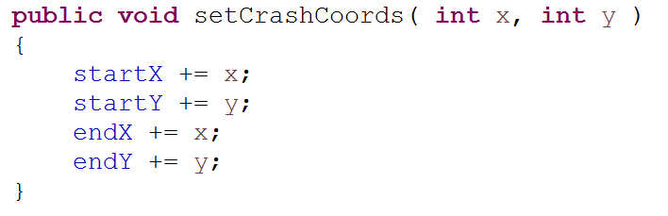
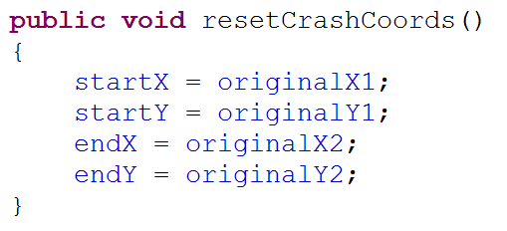
ROCKETPIECE CLASS
draw(…)
Methods
setCrashCoords(…)
resetCrashCoords()

Slide 20
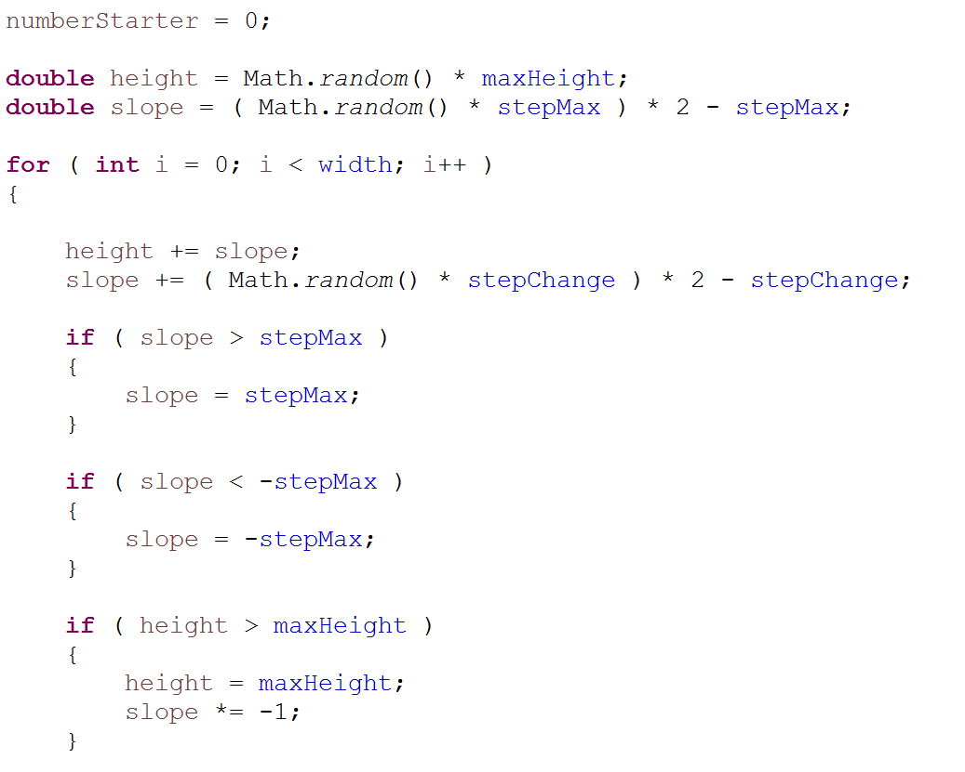
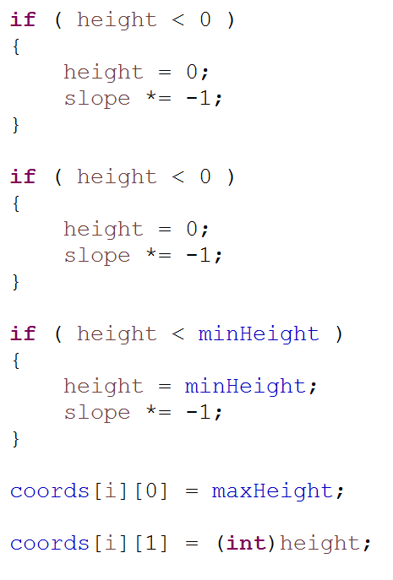
LANDSCAPE CLASS
the terrain of the game
CONSTRUCTOR
FIELDS
int width
int maxHeight
int minHeight
int stepChange
int stepMax
int[][] coords
int zoneWidth
int change
int starter
Polygon shape
int[] xCoords
Int[] yCoords
double[] xValues
double[] yValues
Random Landscape Generation

Slide 21
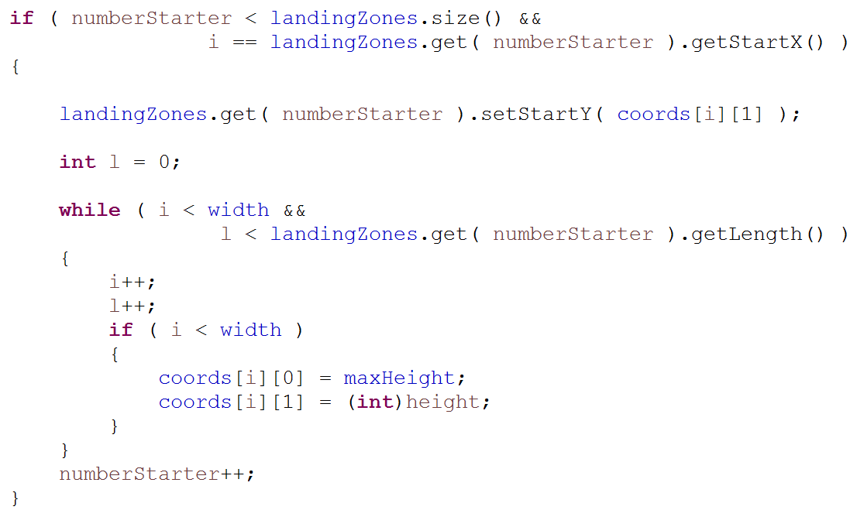
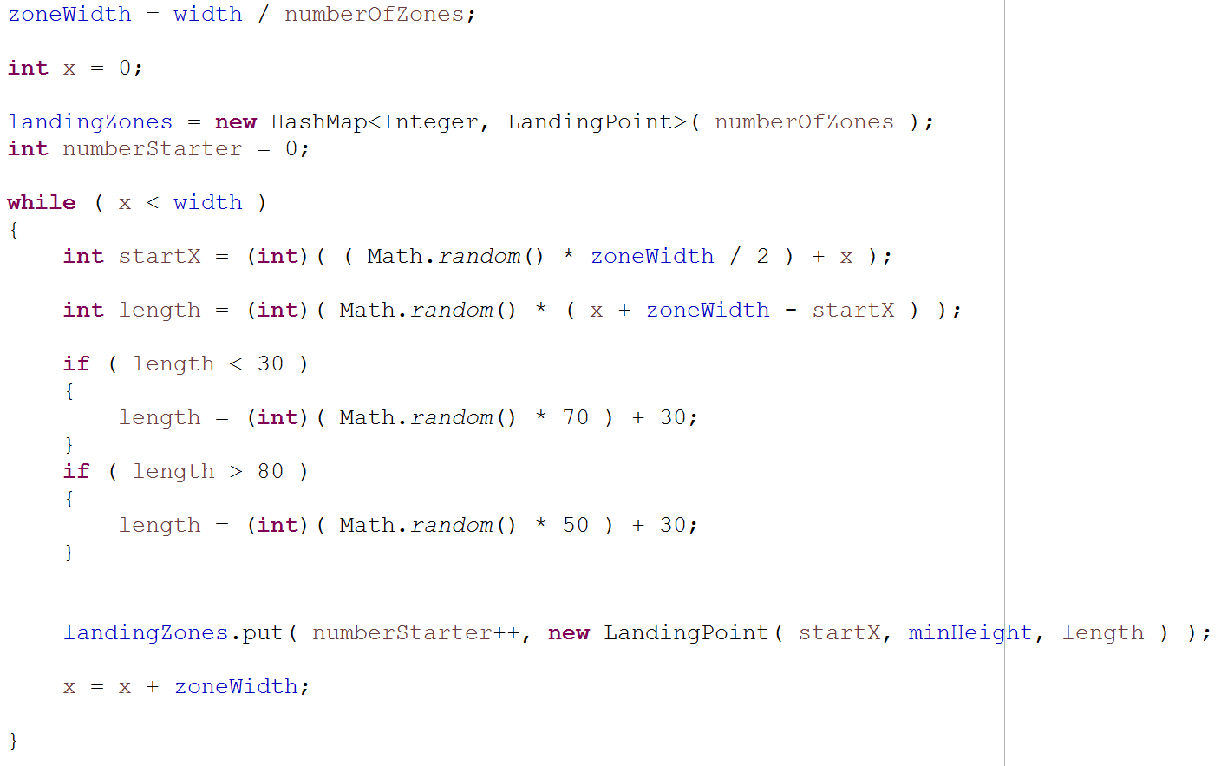
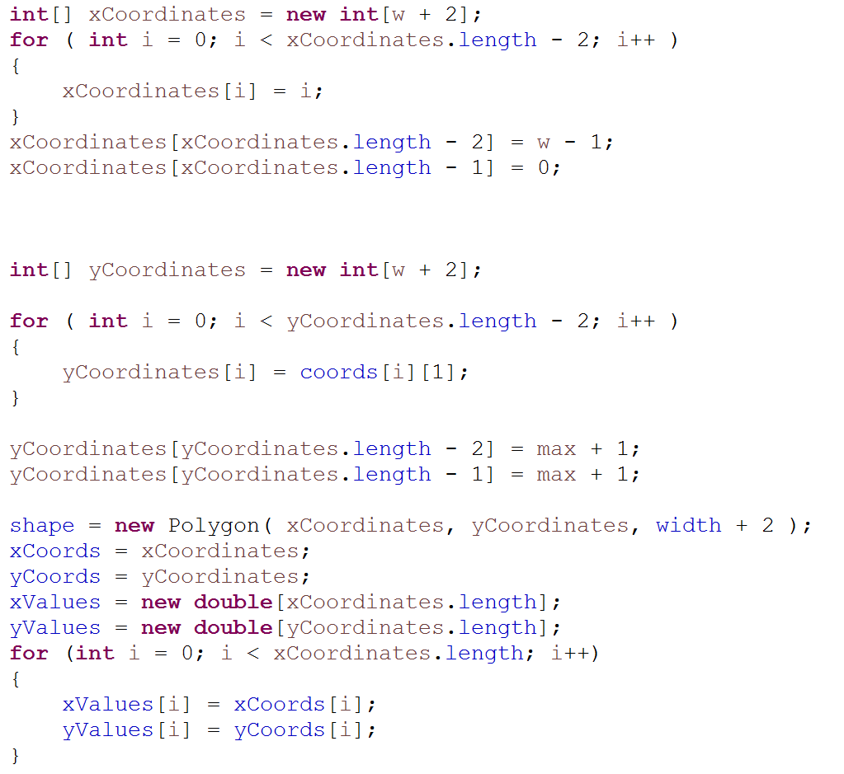
LANDSCAPE CLASS
Constructor
Placing LandingPoints

Slide 22
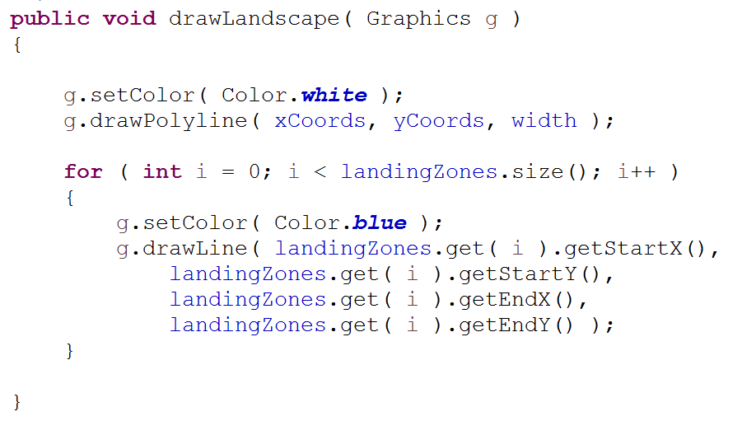
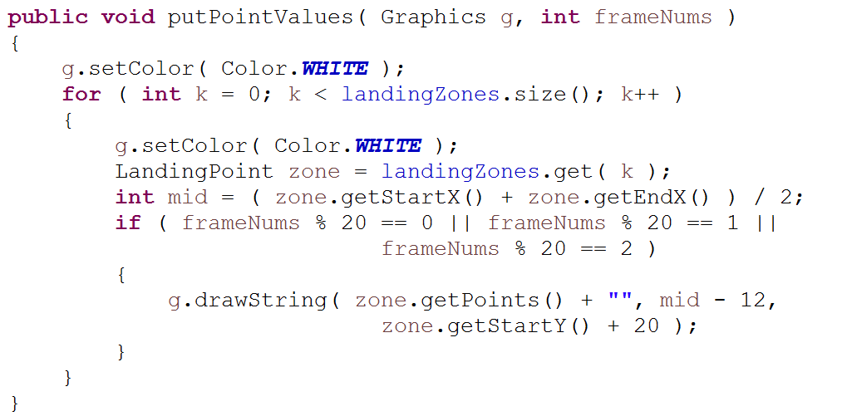
LANDSCAPE CLASS
Methods
drawLandscape(…)
putPointValues(…)

Slide 23
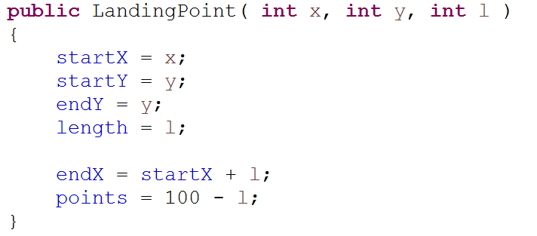
LANDINGPOINT CLASS
Fields
int length
int startX
int startY
int endX
int endY
int points
Methods
getters
Constructor

Slide 24
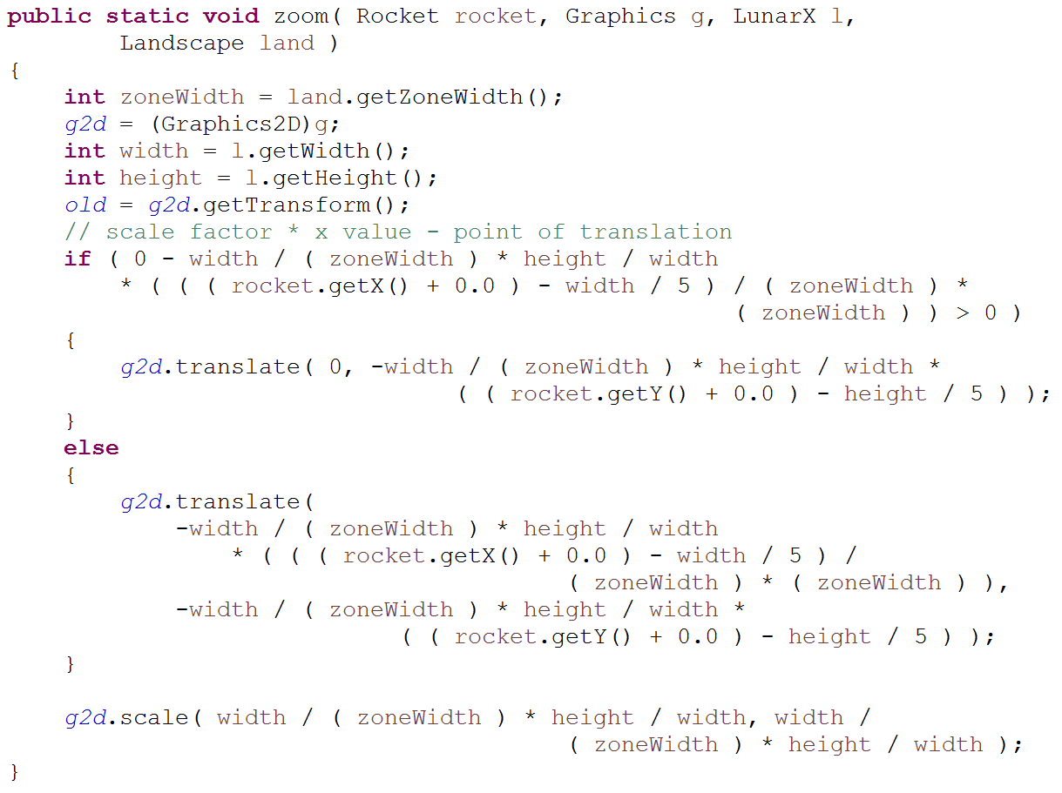
ZOOMER CLASS
handles shifting and zooming of GUI
zoom(…)
Fields
AffineTransform old
Graphics2D g2d
Methods
void zoom(…)
void rotateAboutRocket(…)
void revertToNormal()

Slide 25
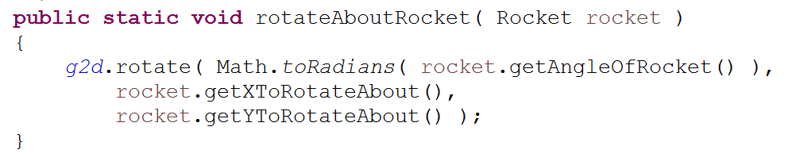
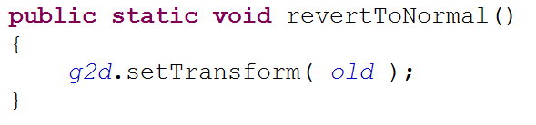
ZOOMER CLASS
rotateAboutRocket(…)
revertToNormal()

Slide 26
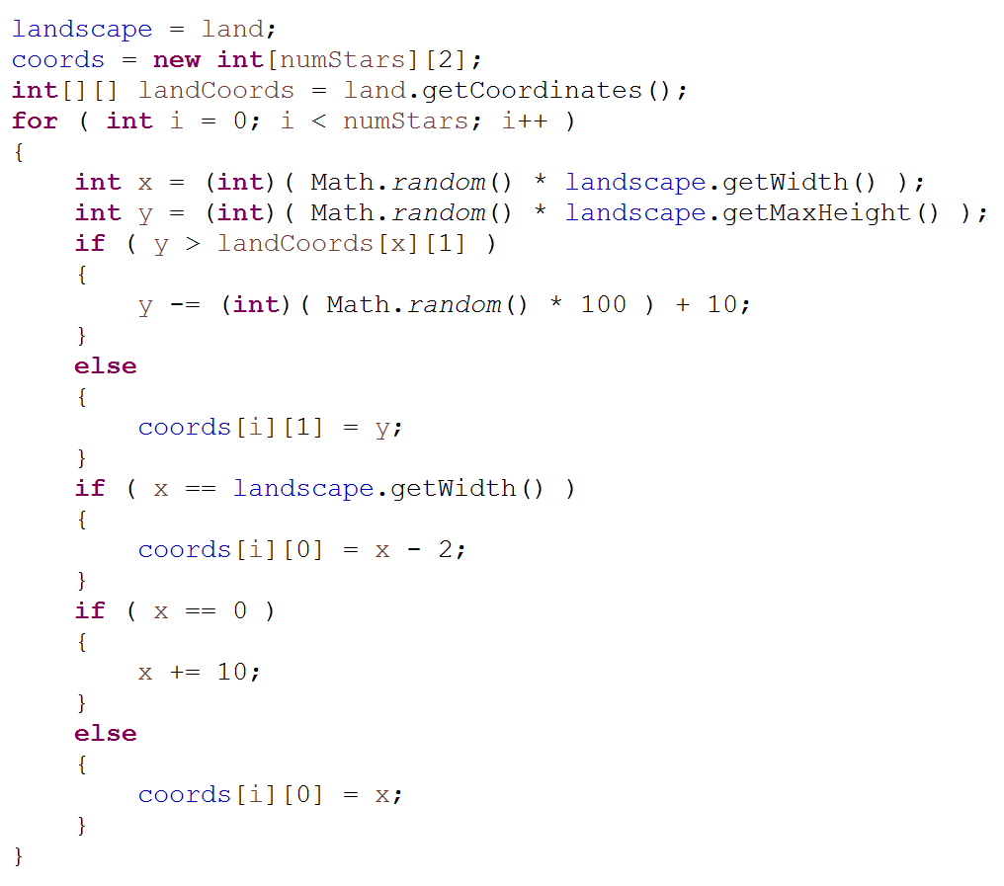
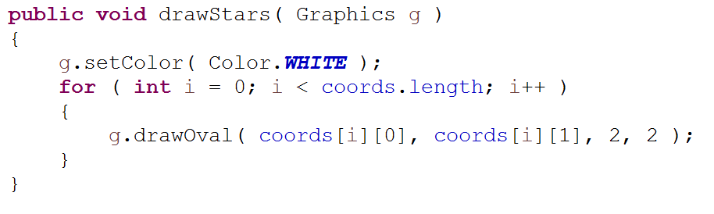
STARS CLASS
the stars in the background of the game
Constructor
Fields
int[][] cords
Landscape landscape
Methods
drawStars(…)

Slide 27
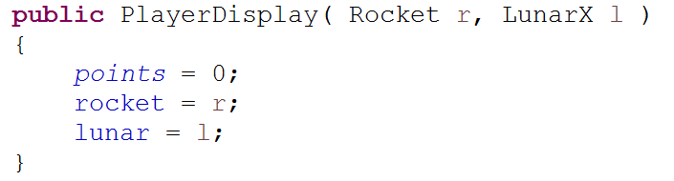
PLAYERDISPLAY CLASS
everything the player sees in terms of information
Fields
Rocket rocket
LunarX lunar
int points
int height
Methods
void showInfo(…)
void showMenu(…)
void gameOver(...)
+getters
ct
Constructor

Slide 28
PROJECT REVIEW
WHAT WENT WELL
WHAT WE’D DO NEXT TIME
Physics
Game Functionality
Coordination
Leave more time for bug fixing
Differentiate tasks at the beginning
Learn about GUI/other concepts before we actually start coding instead of doing it along the way

Slide 29
TURBULANCES
Explosion Coordinates
Timer/Delay
Creation of GUI from scratch
Zoomed Frame
Rocket collision detection with landscape
Time Management
Planning/Differentiating Tasks

Slide 30
TEST FLIGHT

